Slide 1
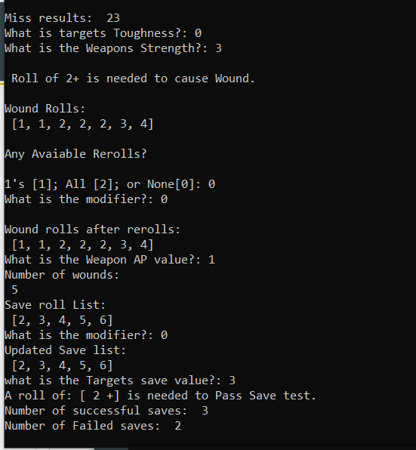
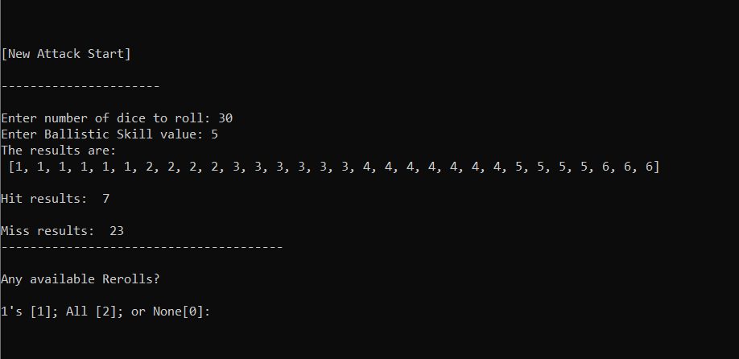
40K Dice Roller Calculator
Matt Janes
https://github.com/ksu-is/40k-Calculator
Automatically rolls dice, lists results, and accounts for positive/negative hit roll modifiers.

